Slide 1




NEXT GEN EMPLOYABILITY PROGRAM
Creating a future-ready workforce
Team Members
College Name
Student Name : AVINASH .R
Student ID :511321205003
KINGSTON ENGINEERING COLLEGE

Slide 2

CAPSTONE PROJECT SHOWCASE
Project Title
Building Bus Reservation System using Python and Django
Abstract | Problem Statement | Project Overview | Proposed Solution | Technology Used | Modelling & Results | Conclusion

Slide 3
Abstract
The Bus Reservation System is an essential application for managing bus ticket bookings efficiently. In this project, we propose the development of a Bus Reservation System using Python and the Django web framework. The system aims to provide a user-friendly interface for both passengers and administrators to perform various tasks related to bus ticket reservations, cancellations, and management.
Key features of the Bus Reservation System include:
User Registration and Authentication: Passengers can create accounts, login securely, and manage their profiles.
Bus Route Management: Administrators can add, update, and delete bus routes, including details such as origin, destination, departure time, and fare.
Source :

Slide 4
Problem Statement
The current bus ticket reservation process often involves manual intervention, leading to inefficiencies and inconvenience for both passengers and bus operators. There is a need for a modern, automated solution to streamline the bus reservation process and enhance the overall experience for users.
The objective of this project is to develop a Bus Reservation System using Python and Django that addresses the following challenges:
Manual Booking Process: The existing process of booking bus tickets typically involves manual ticket issuance, which is time-consuming and prone to errors. This system aims to automate the booking process to eliminate manual intervention and improve efficiency.
Source :

Slide 5
Project Overview
The Bus Reservation System project aims to develop a comprehensive web application using Python and Django framework to facilitate efficient bus ticket reservations. The system will provide a user-friendly interface for passengers to search for bus routes, check seat availability, make bookings, and manage their reservations. Additionally, administrators will have access to tools for managing bus routes, monitoring bookings, and generating reports.
Key components and functionalities of the Bus Reservation System include:
User Authentication and Authorization:
Passengers can register accounts and log in securely.
Administrators have privileged access for managing system data.
Source :

Slide 6
Proposed Solution
.
To build the Bus Reservation System using Python and Django, we will follow a structured approach to ensure the development of a robust and efficient application. Below is an outline of the proposed solution:
1.Setup and Configuration:
Install Python and Django framework.
Create a new Django project and set up the project directory structure.
2.Database Design:
Design the database schema to store information such as bus routes, bookings, passengers, and administrators.
Define models using Django's ORM (Object-Relational Mapping) to represent database tables and relationships.
Source :

Slide 7
Proposed solution
3.Administrative Dashboard: Develop a comprehensive administrative dashboard for bus operators to manage bookings, ticketing, and operational insights. Provide analytics and reporting tools to optimize resource utilization and revenue generation.
4.Integration with External APIs: Integrate with external APIs such as Google Maps API for route mapping and location tracking, and payment gateway APIs for secure transactions. Ensure seamless communication and interoperability with third-party services.
5.Testing and Quality Assurance: Conduct thorough testing at each stage of development to identify and resolve issues promptly. Implement automated testing frameworks for regression testing and ensure compliance with quality standards.
6.Documentation and Training: Prepare comprehensive documentation including user manuals, API documentation, and deployment guides. Provide training sessions for administrators and support staff to ensure smooth adoption and operation of the system.
7.Deployment and Maintenance: Deploy the bus reservation system on reliable and scalable infrastructure, ensuring high availability and performance. Implement monitoring and alerting systems to proactively identify and address any issues that may arise. Regularly update and maintain the system to incorporate new features and enhancements.
8.Dynamic Scheduling: Implement flexible scheduling mechanisms to accommodate changes in routes, timings, and demand patterns. Allow for easy adjustment of schedules and routes based on feedback and operational requirements.
Source :

Slide 8


Technology Used
Front-end
Back-end
Source :

Slide 9
Modelling & Results
a.Requirements Gathering: Gather requirements from stakeholders including passengers, bus operators, and administrators. Define functional and non-functional requirements to guide system design.
b. System Design: Design the architecture, database schema, and user interface. Use tools such as UML diagrams to illustrate the system's structure and behavior. Define the relationships between different components and modules.
c. Database Design: Create a database schema to store information about buses, routes, schedules, bookings, and passengers. Define appropriate tables, indexes, and relationships to ensure efficient data storage and retrieval.
d. Algorithm Design: Develop algorithms for seat allocation, schedule optimization, and real-time updates. Use techniques such as greedy algorithms, dynamic programming, and heuristic approaches to solve allocation and scheduling problems efficiently.
Source :

Slide 10
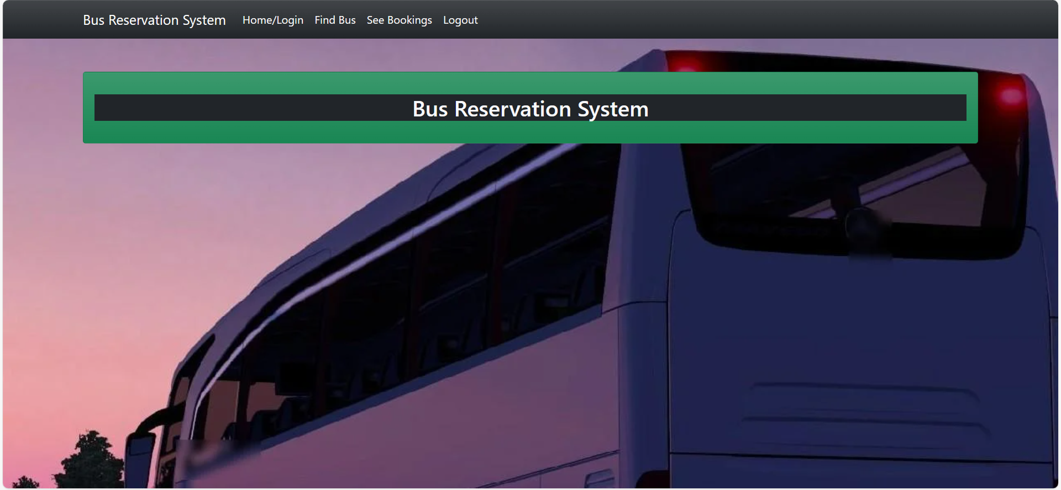
Home Page

Slide 11
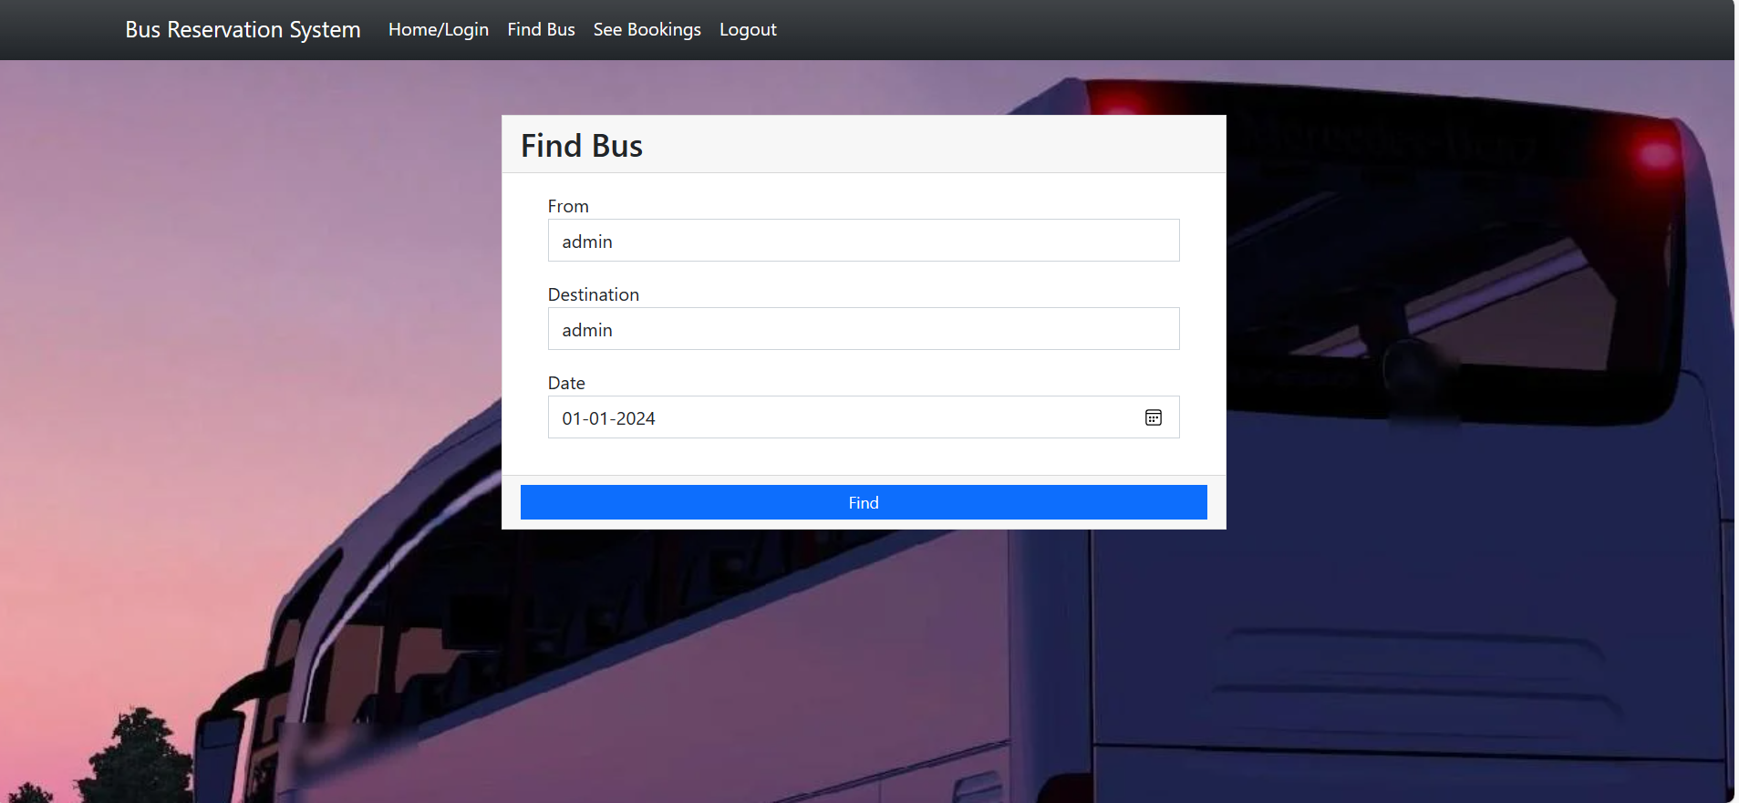
About us Page

Slide 12
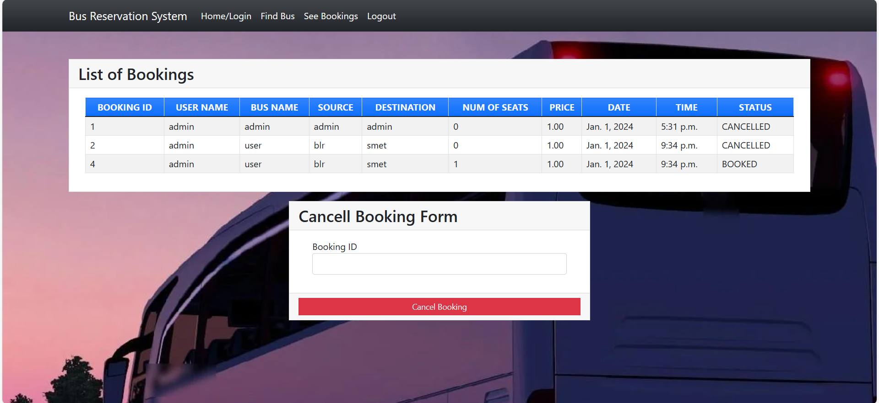
Service-Page

Slide 13
Departments-Page

Slide 14
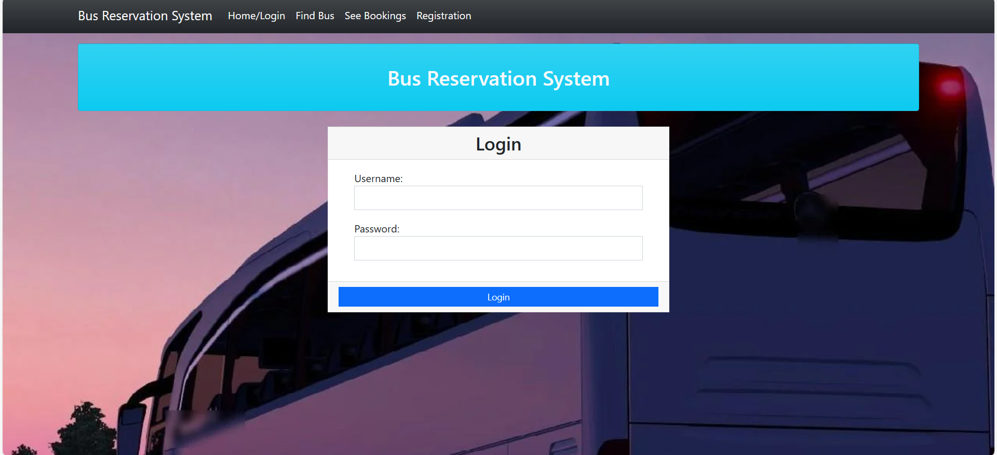
Blog-Page

Slide 15
Future Enhancements:
Future enhancements for a bus reservation system can focus on improving user experience, expanding functionality, and incorporating emerging technologies. Here are some potential areas for enhancement:
Real-Time Updates: Integrate real-time tracking and updates for buses, allowing users to track the location and estimated arrival time of their bus. This feature enhances transparency and helps users plan their journey more accurately.
Personalized Recommendations: Implement machine learning algorithms to analyze user preferences and behavior, offering personalized recommendations for bus routes, schedules, and promotions. This enhances user engagement and satisfaction by delivering relevant content.
Mobile App Development: Develop a dedicated mobile app for the bus reservation system, providing users with a seamless booking experience on their smartphones. The app can offer additional features such as push notifications, offline access to tickets, and in-app customer support.
Payment Gateway Integration: Expand payment options by integrating additional payment gateways and digital wallets, allowing users to choose their preferred payment method for booking tickets securely. Support for cryptocurrencies and other emerging payment methods can also be considered.
Social Integration: Enable social media integration, allowing users to log in or sign up using their social media accounts. Additionally, integrate social sharing features to allow users to share their travel plans and experiences with friends and followers.
Accessibility Features: Improve accessibility by implementing features such as screen reader compatibility, keyboard navigation, and text resizing options. Ensuring that the system complies with accessibility standards enhances inclusivity and usability for all users.
Multi-Language Support: Offer support for multiple languages to cater to a diverse user base. Allow users to switch between languages seamlessly, providing a localized experience and improving accessibility for non-native speakers.
Customer Feedback Mechanism: Implement a feedback mechanism to gather user feedback and suggestions for continuous improvement. Analyze feedback data to identify areas for enhancement and prioritize feature development based on user needs and preferences.
Integration with Transportation Networks: Collaborate with other transportation providers such as railways, airlines, and ride-sharing services to offer integrated travel solutions. Provide seamless connectivity and booking options for multi-modal journeys.

Slide 16
Conclusion
Key components of the system include:
Homepage: The homepage serves as the entry point, welcoming users and providing quick access to essential functionalities such as searching for bus routes, viewing schedules, and making reservations.
Navigation: A clear and intuitive navigation menu allows users to easily explore different sections of the website, including bus routes, schedules, booking options, user authentication, and more.
Search Functionality: Users can search for buses by entering their origin and destination, along with optional parameters such as travel date and time. The system retrieves relevant information and presents it to the user for selection.
User Authentication: Registered users can sign in to their accounts to access personalized features such as booking history, profile management, and preferences. New users have the option to sign up for an account.
Responsive Design: The system is designed to be responsive, ensuring a seamless user experience across various devices and screen sizes, including desktops, laptops, tablets, and smartphones.
Backend Functionality: Django and Python power the backend of the system, handling tasks such as data storage, retrieval, and processing, user authentication, and business logic implementation.
Scalability and Flexibility: The system is built with scalability and flexibility in mind, allowing for easy expansion and customization to meet evolving business needs and user requirements.
Source :

Slide 17
Thank You!
Notes:
Thank You !!

